Slide 1
Topic 1. Review: Probability and Statistics

Slide 2
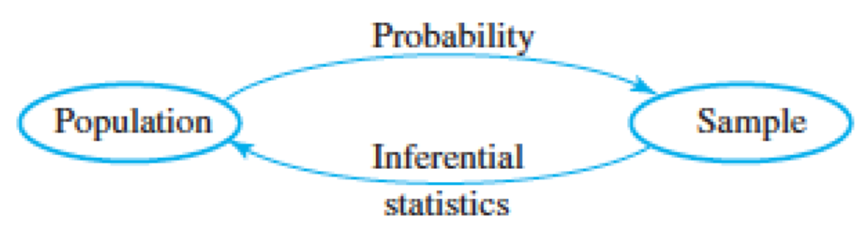
Population and Sample
Population is the whole set of individuals about which we attempt to draw conclusion.
Sample is a part of population which is observed.
Relation between population and sample
Some toy examples
Flip a fair coin 10K times, what is the probability of observing 5.2K H’s?
If 5.2K H’s are observed, is the coin fair?

Slide 3
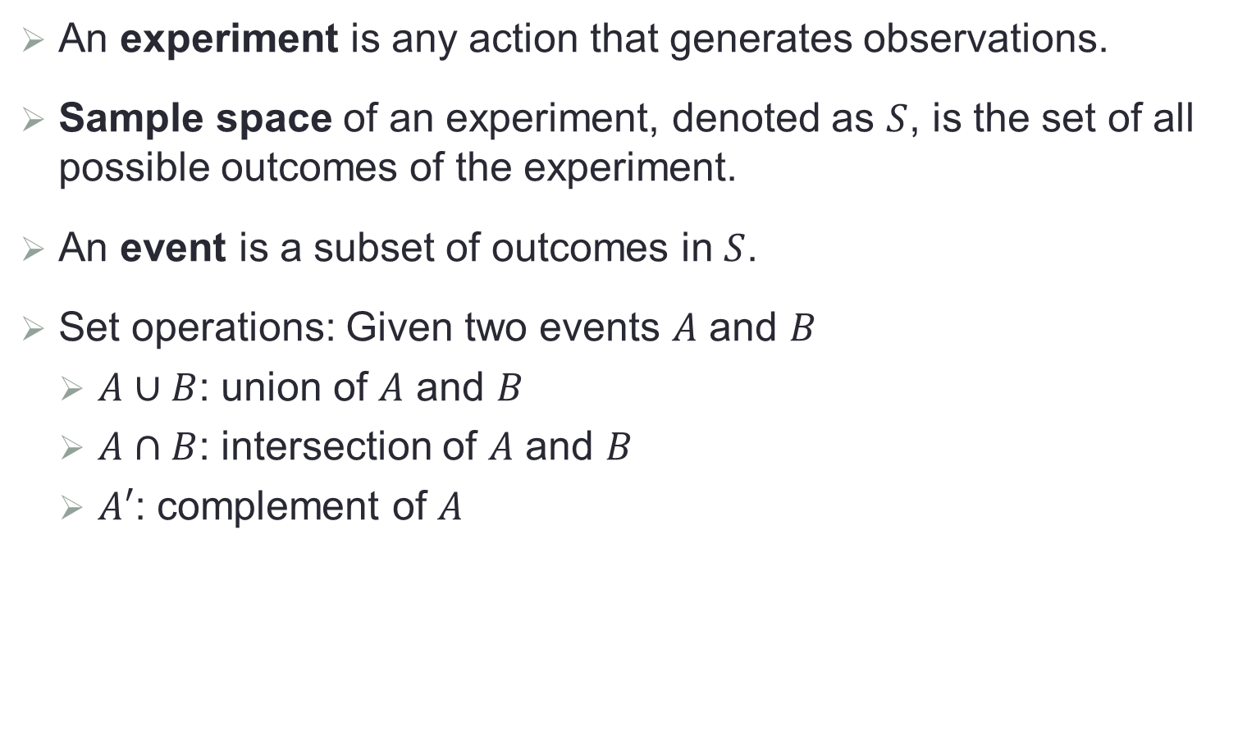
Basics of Probability
An experiment is any action that generates observations.
Sample space of an experiment, denoted as $S$, is the set of all possible outcomes of the experiment.
An event is a subset of outcomes in $S$.
Set operations: Given two events $A$ and $B$
$A∪B$: union of $A$ and $B$
$A∩B$: intersection of $A$ and $B$
$A′$: complement of $A$

Slide 4
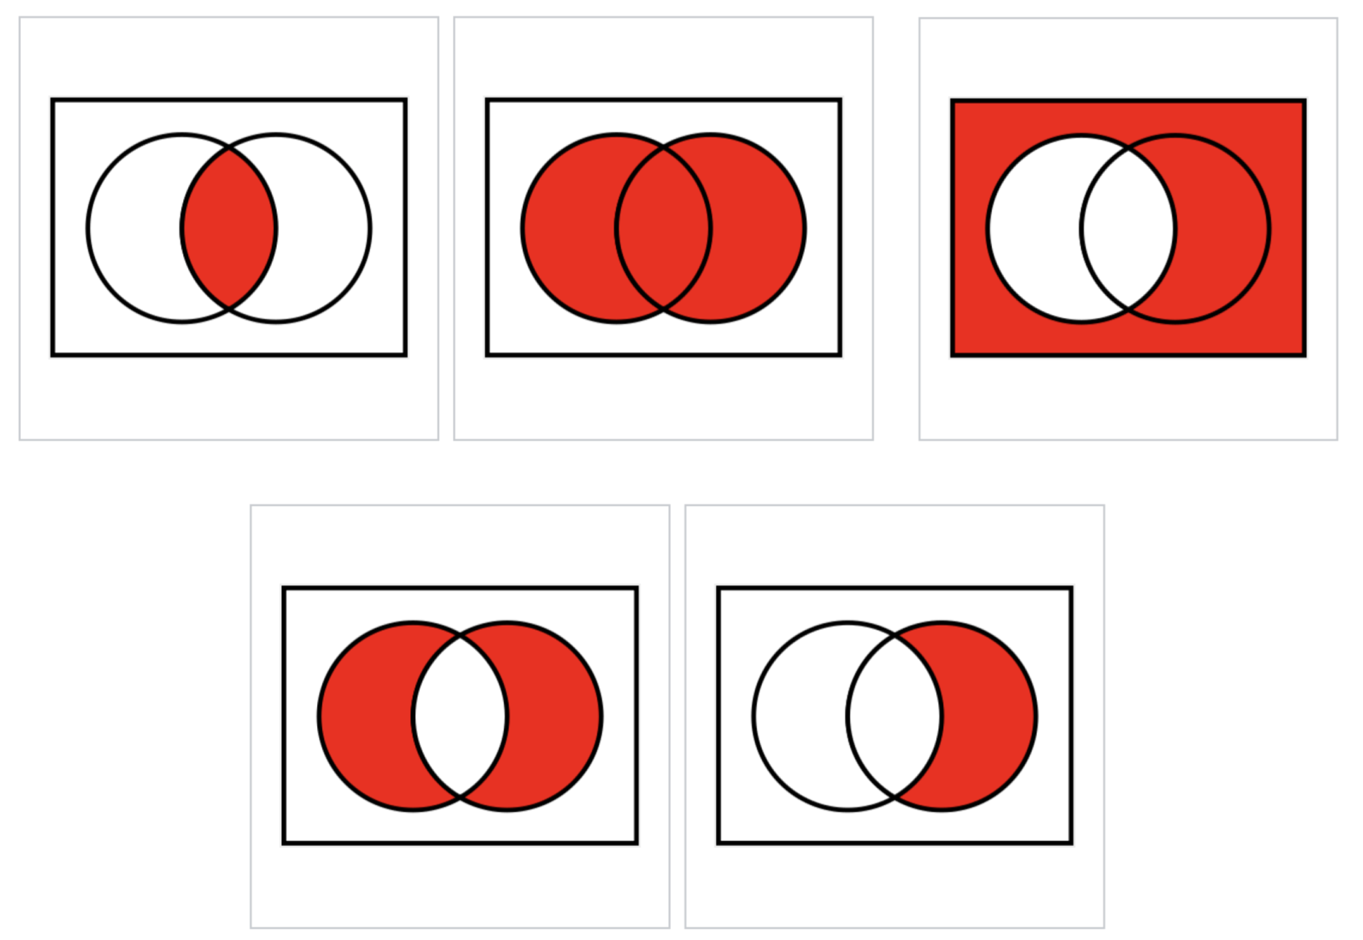
Venn Diagram

Slide 5
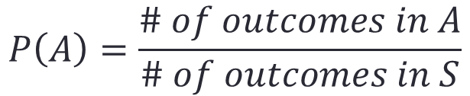
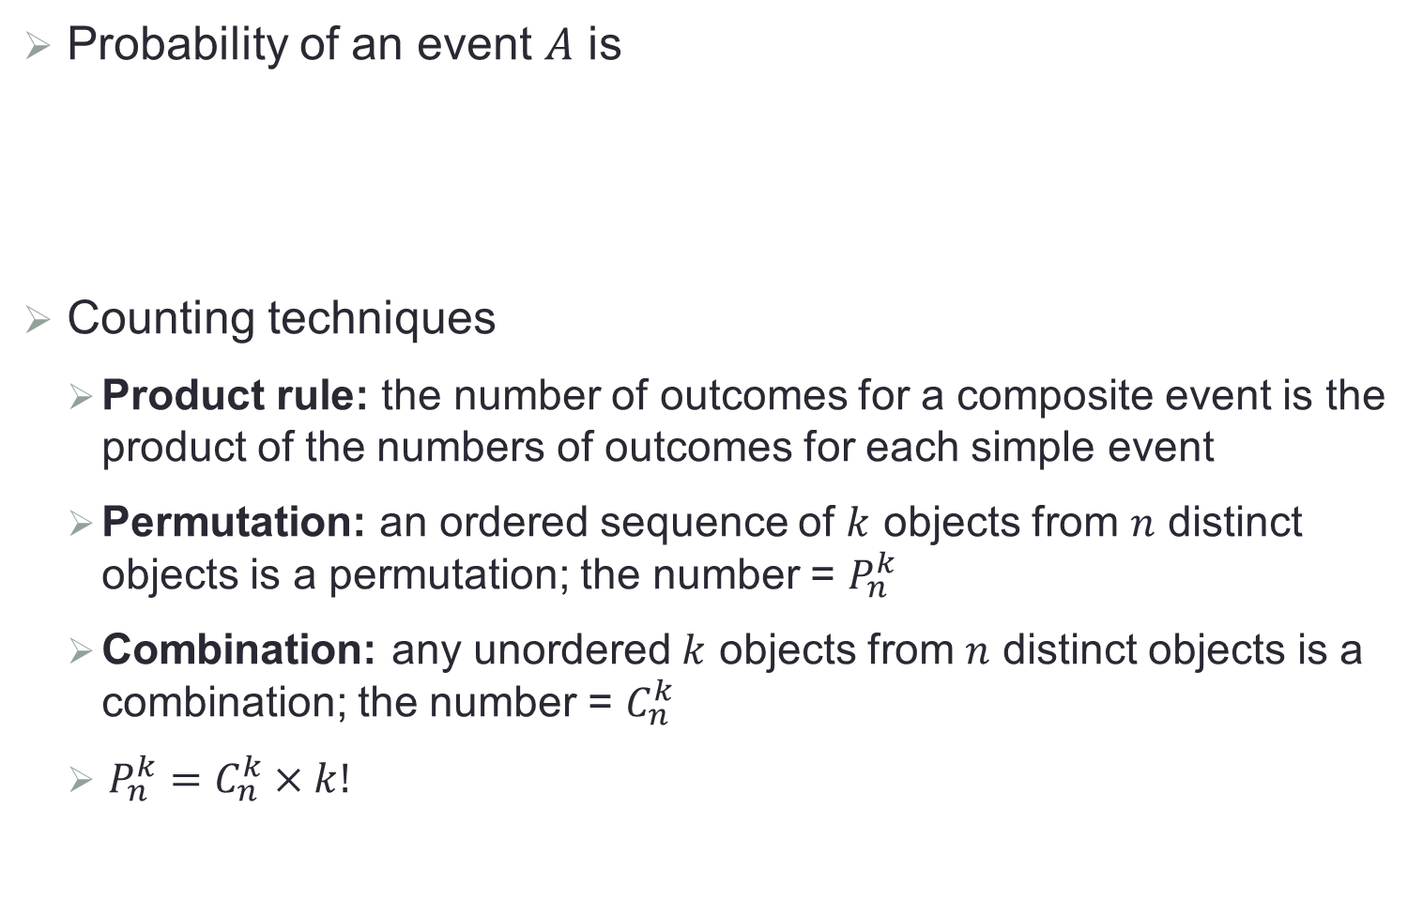
Probability
Probability of an event $A$ is
Counting techniques
Product rule: the number of outcomes for a composite event is the product of the numbers of outcomes for each simple event
Permutation: an ordered sequence of $k$ objects from $n$ distinct objects is a permutation; the number = $P_{n}^{k}$
Combination: any unordered $k$ objects from $n$ distinct objects is a combination; the number = $C_{n}^{k}$
$P_{n}^{k}=C_{n}^{k}×k!$
$$P\left(A\right)=\frac{\# of outcomes in A}{\# of outcomes in S}$$

Slide 6
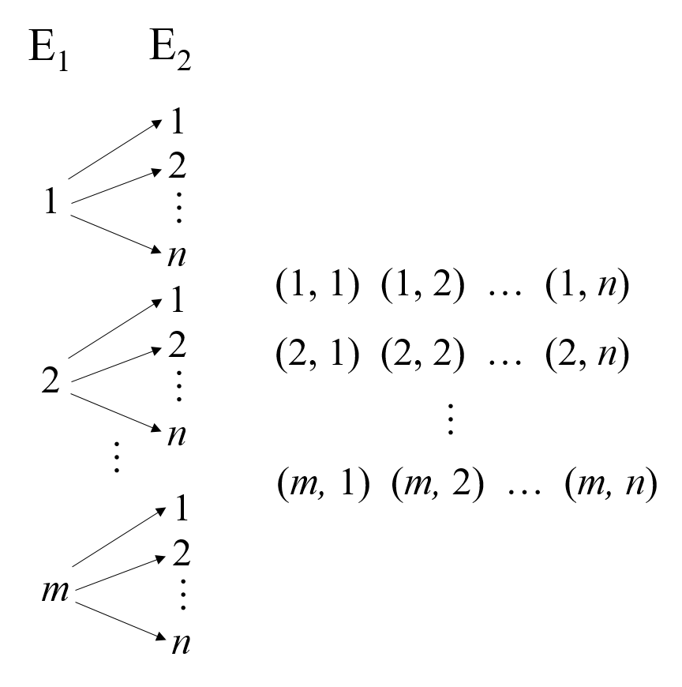
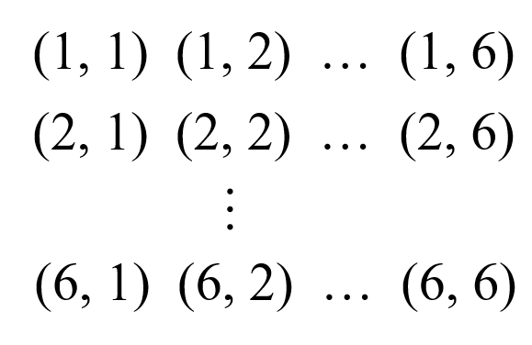
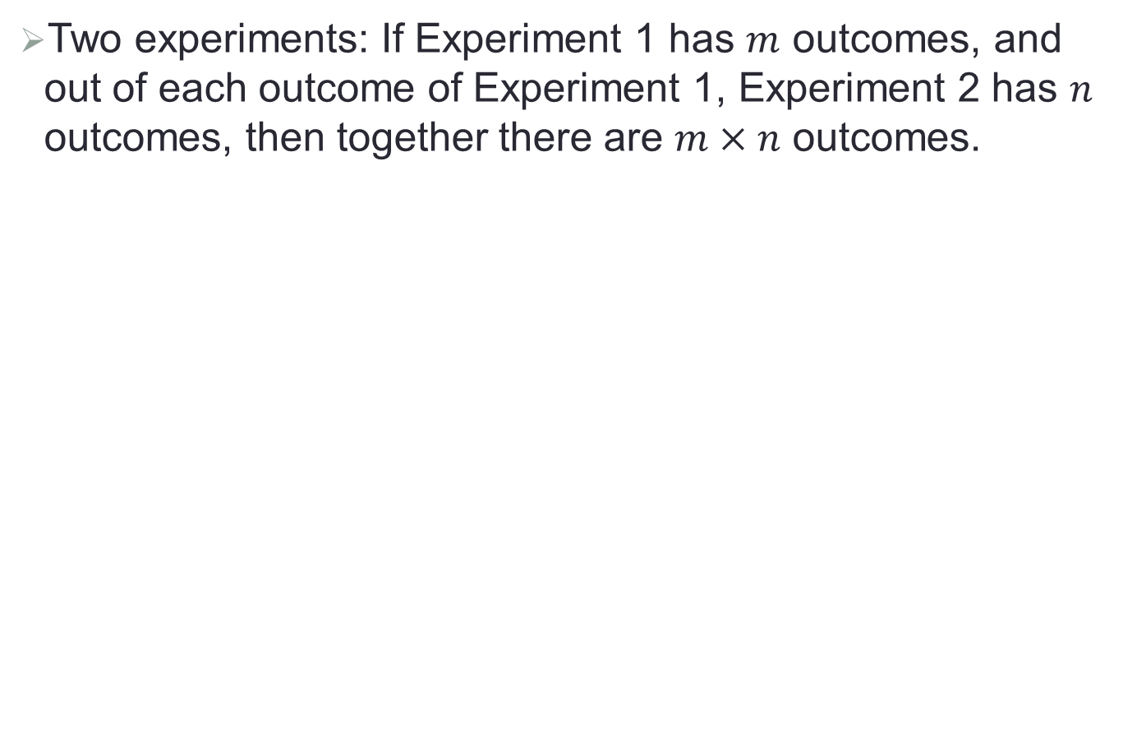
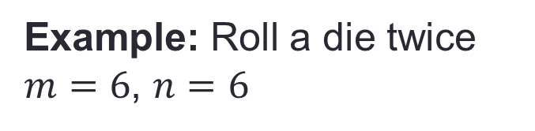
Product Rule
Two experiments: If Experiment 1 has $m$ outcomes, and out of each outcome of Experiment 1, Experiment 2 has $n$ outcomes, then together there are $m×n$ outcomes.
Example: Roll a die twice
$m=6$, $n=6$

Slide 7
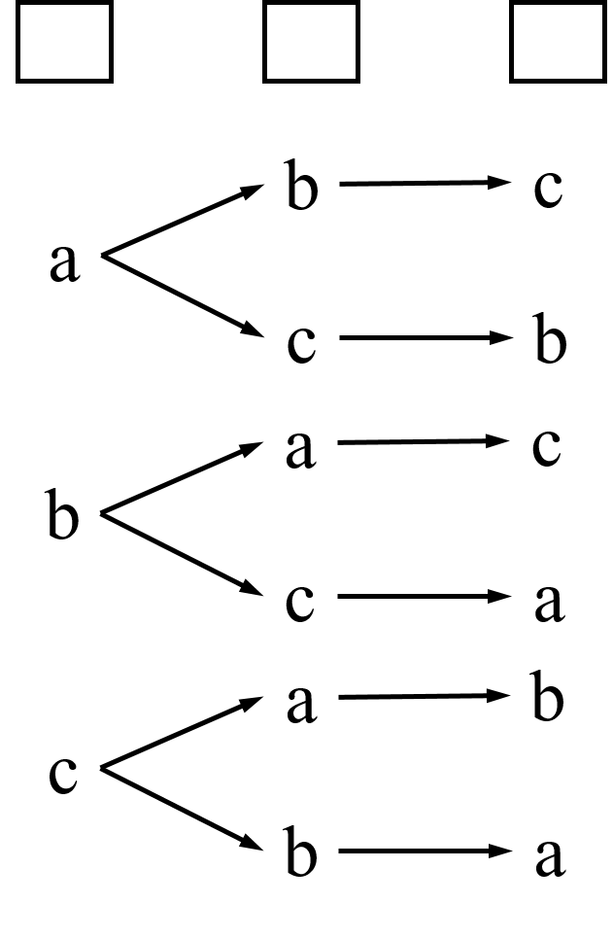


Permutation
  # ways to arrange $n$ distinct objects:
  $P_{n}^{k}=\frac{n!}{\left(n−r\right)!}=n×\left(n−1\right)×\left(n−2\right)…×(n−r+1)$
Example: Number of ways to order letters {a, b, c}
$$P_{3}^{3}=3!=3×2×1=6$$

Slide 8
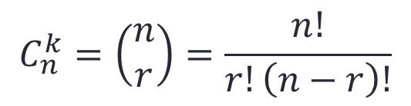
Combinations
  # ways to select $r$ objects from a set of $n$ objects:
$$C_{n}^{k}=\left(\begin{matrix}n \\ r\end{matrix}\right)=\frac{n!}{r!\left(n−r\right)!}$$
Example: Number of ways to select 3 from {a, b, c, d, e}
{a, b, c}, {a, b, d}, {a, b, e}, {a, c, d},…
$$C_{5}^{3}=\left(\begin{matrix}5 \\ 3\end{matrix}\right)=\frac{5!}{3!×2!}=\frac{5×4×3×2!}{3!×2!}=\frac{5×4×3}{3×2×1}=10$$

Slide 9
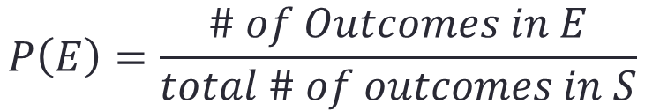

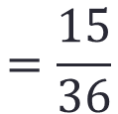
Example of Probability Calculation
  A pair of fair dice is rolled. What is the probability that the second die lands on a higher value than the first?
Let $S$: All possible outcomes of rolling two dice
$E$: Second die has higher value than the first die
11 12 13 14 15 16
22 23 24 25 26
32 33 34 35 36
42 43 44 45 46
52 53 54 55 56
61 62 63 64 65 66
$$P\left(E\right)=\frac{\# of Outcomes in E}{total \# of outcomes in S}$$
$$=\frac{15}{36}$$

Slide 10
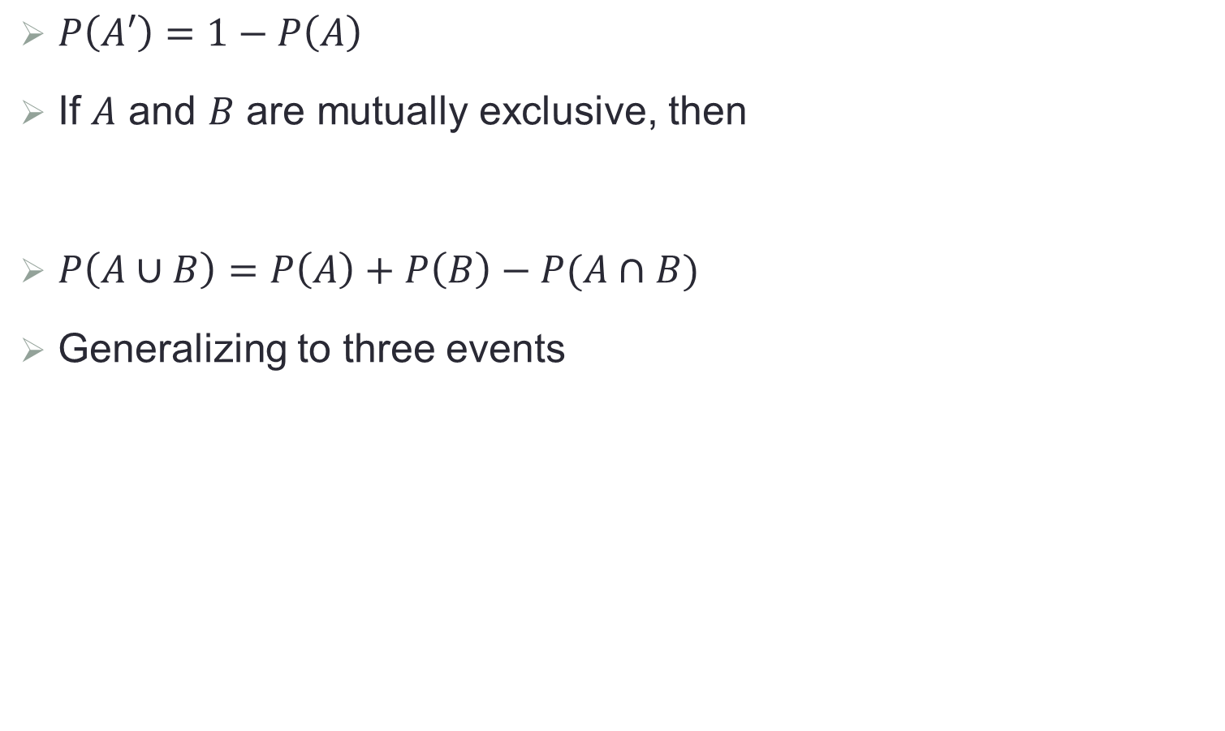


Axioms of Probability
$P\left(A′\right)=1−P\left(A\right)$
If $A$ and $B$ are mutually exclusive, then
$P\left(A∪B\right)=P\left(A\right)+P\left(B\right)−P(A∩B)$
Generalizing to three events
$$P\left(A∩B\right)=P\left(∅\right)=0$$
$$P\left(A∪B∪C\right)=P\left(A\right)+P\left(B\right)+P\left(C\right)$$
$$−P\left(A∩B\right)−P\left(A∩C\right)−P\left(B∩C\right)$$
$$+P\left(A∩B∩C\right)$$
Notes:
B

Slide 11
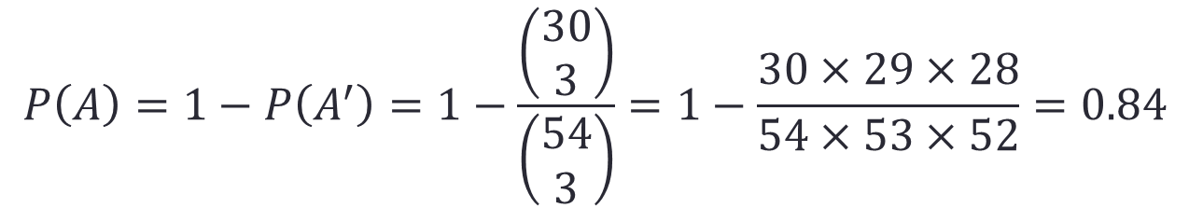
Example of Probability Calculation
  There are 30 psychiatrists and 24 psychologists attending a certain conference. Three of these 54 people are randomly chosen to take part in a panel discussion. What is the probability that at least one psychologist is chosen?
Let $A$: At least one psychologist is chosen
$$P\left(A\right)=1−P\left(A^{′}\right)=1−\frac{\left(\begin{matrix}30 \\ 3\end{matrix}\right)}{\left(\begin{matrix}54 \\ 3\end{matrix}\right)}=1−\frac{30×29×28}{54×53×52}=0.84$$

Slide 12
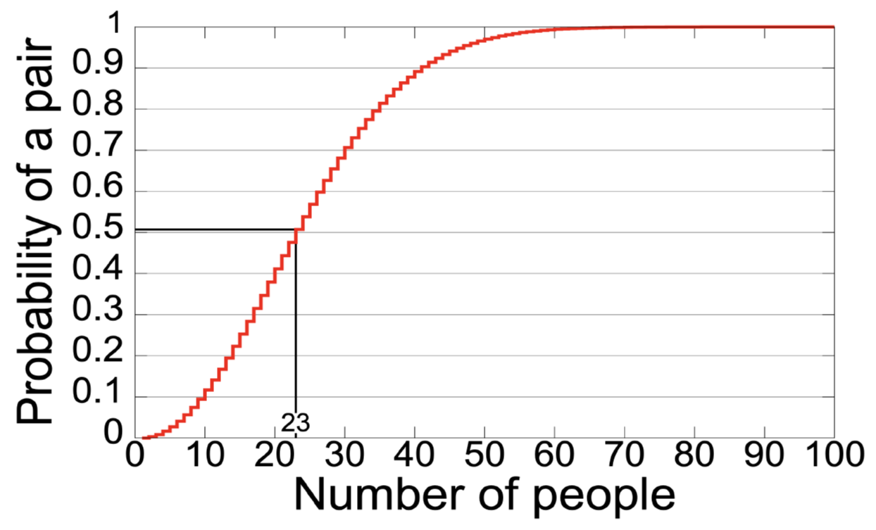
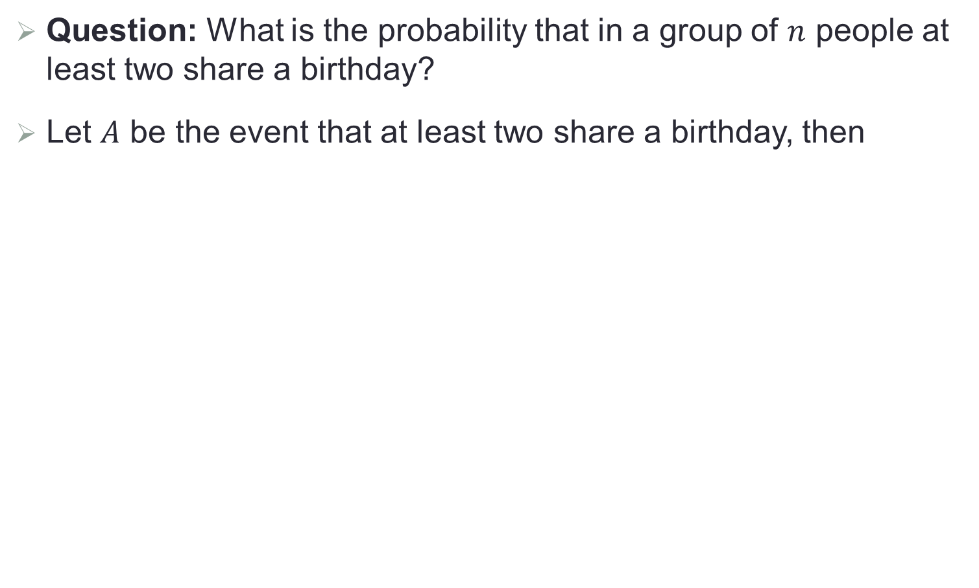
Birthday Paradox
Question: What is the probability that in a group of $n$ people at least two share a birthday?
Let $A$ be the event that at least two share a birthday, then
$$P\left(A\right)=1−P\left(A^{′}\right)=1−\frac{365×364×…×(365−n+1)}{{365}^{n}}$$

Slide 13
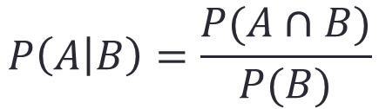
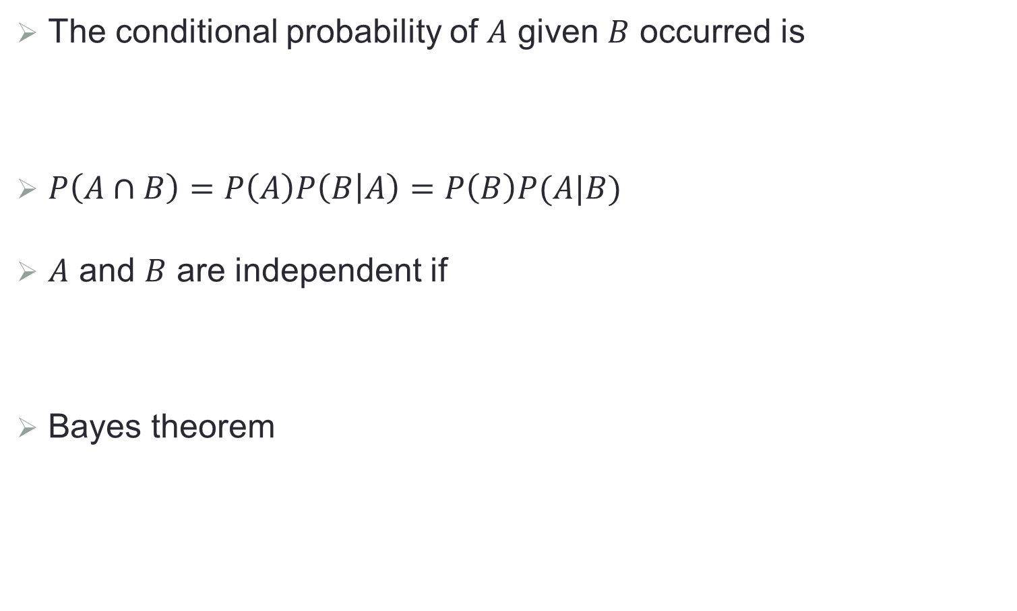
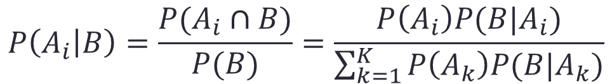
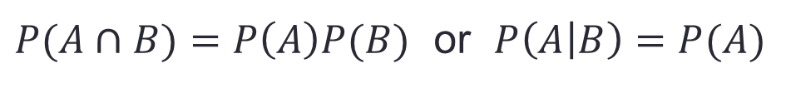
Conditional Probability
The conditional probability of $A$ given $B$ occurred is
$P\left(A∩B\right)=P\left(A\right)P\left(B | A\right)=P\left(B\right)P(A|B)$
$A$ and $B$ are independent if
Bayes theorem
$$P\left(A | B\right)=\frac{P(A∩B)}{P(B)}$$
$P(A∩B)=P\left(A\right)P(B)$ or $P\left(A | B\right)=P(A)$
$$P\left(A_{i} | B\right)=\frac{P(A_{i}∩B)}{P(B)}=\frac{P\left(A_{i}\right)P(B|A_{i})}{\sum_{k=1}^{K}{P\left(A_{k}\right)P(B|A_{k})}}$$

Slide 14
Bayes Theorem

Slide 15
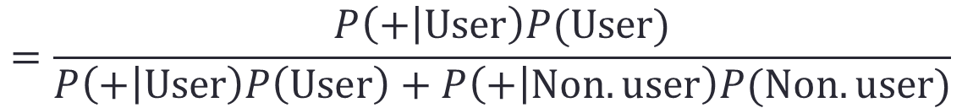
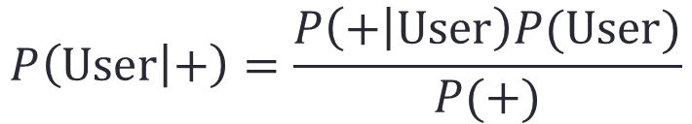

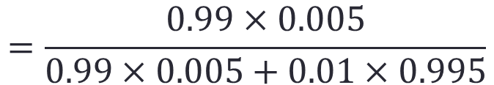
Drug Testing
Question: Suppose that a drug test produces 99% true positive results for drug users and 99% true negative results for non-drug users. Suppose that 0.5% of people are drug users. What is the probability that a random individual with a positive test is a drug user?
$$P\left(User | +\right)=\frac{P\left(+ | User\right)P(User)}{P(+)}$$
$$=\frac{P\left(+ | User\right)P(User)}{P\left(+ | User\right)P\left(User\right)+P\left(+ | Non.user\right)P(Non.user)}$$
$$=\frac{0.99×0.005}{0.99×0.005+0.01×0.995}$$
$$=33.2\%$$

Slide 16

The Monty Hall Problem
Question: Say you're on a game show where there are three doors. Behind two of the doors, there are goats. Behind one of the doors, there is a brand new car.
The host says that once you pick a door, he'll open one of the doors you didn't pick to reveal a goat. Then, you can either stay with your door or switch to the last unopened door.
Do you switch or stay?

Slide 17
Random Variable
A random variable is any characteristic(s) whose value(s) may change from one individual to another.
Descriptive statistics
Numerical
Location: mean, median, trimmed mean
Variability: variance, standard deviation
Graphical
Histogram: frequency, relative frequency, density
Pie chart: proportion
Boxplot: median, 1st quantile, 3rd quantile, outlier

Slide 18
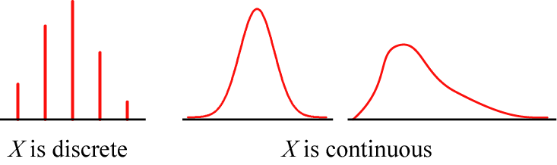

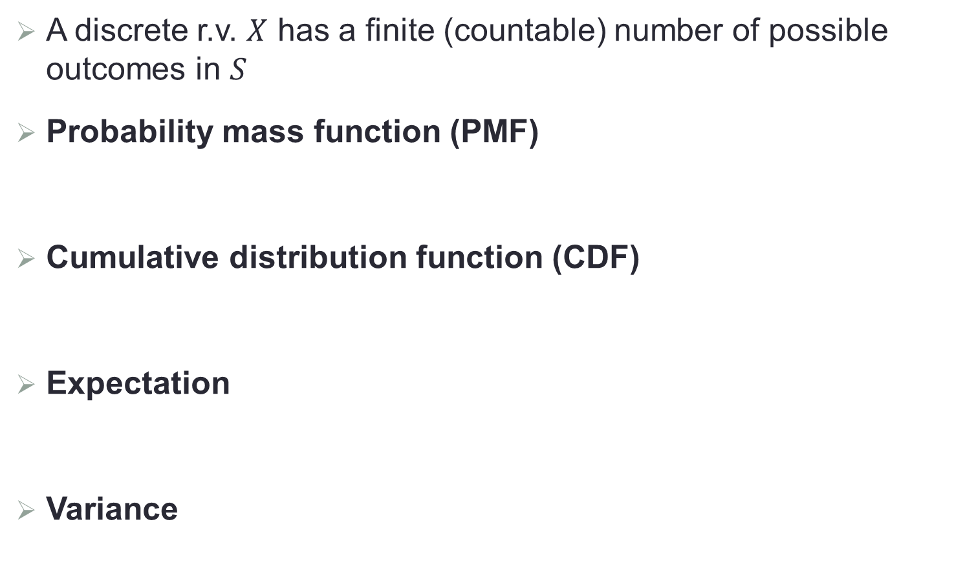
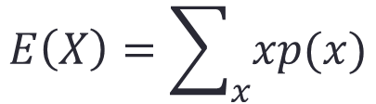
Discrete Random Variable
A discrete r.v. $X$ has a finite (countable) number of possible outcomes in $S$
Probability mass function (PMF)
Cumulative distribution function (CDF)
Expectation
Variance
$$p\left(x\right)=P(s∈S:X\left(s\right)=x)$$
$$F\left(x\right)=P\left(X≤x\right)=P(s∈S:X\left(s\right)≤x)$$
$$E\left(X\right)=\sum_{x}{xp(x)}$$
$$Var\left(X\right)=E{\left[X−E(X)\right]}^{2}=E\left(X^{2}\right)−{\left[E(X)\right]}^{2}$$

Slide 19

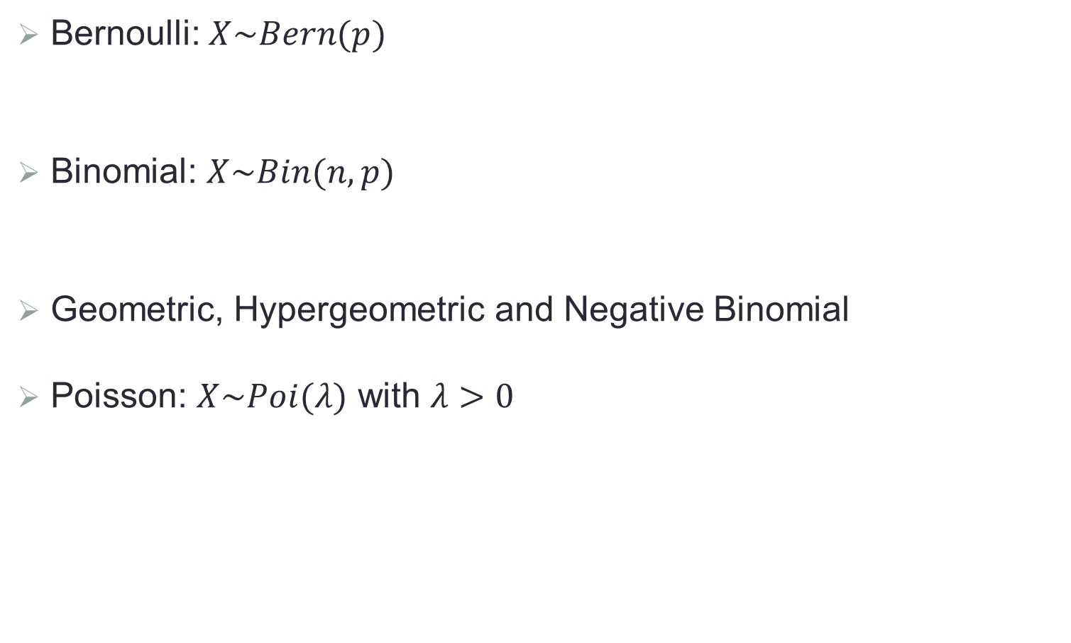
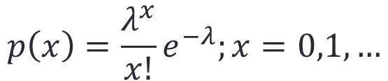

Popular Discrete Random Variables
Bernoulli: $X\sim Bern(p)$
Binomial: $X\sim Bin(n,p)$
Geometric, Hypergeometric and Negative Binomial
Poisson: $X\sim Poi(λ)$ with $λ>0$
$$p\left(x\right)=p^{x}{(1−p)}^{1−x};x=0,1$$
$$p\left(x\right)={C_{n}^{x}p}^{x}{(1−p)}^{n−x};x=0,1,…,n$$
$$p\left(x\right)=\frac{λ^{x}}{x!}e^{−λ};x=0,1,…$$

Slide 20

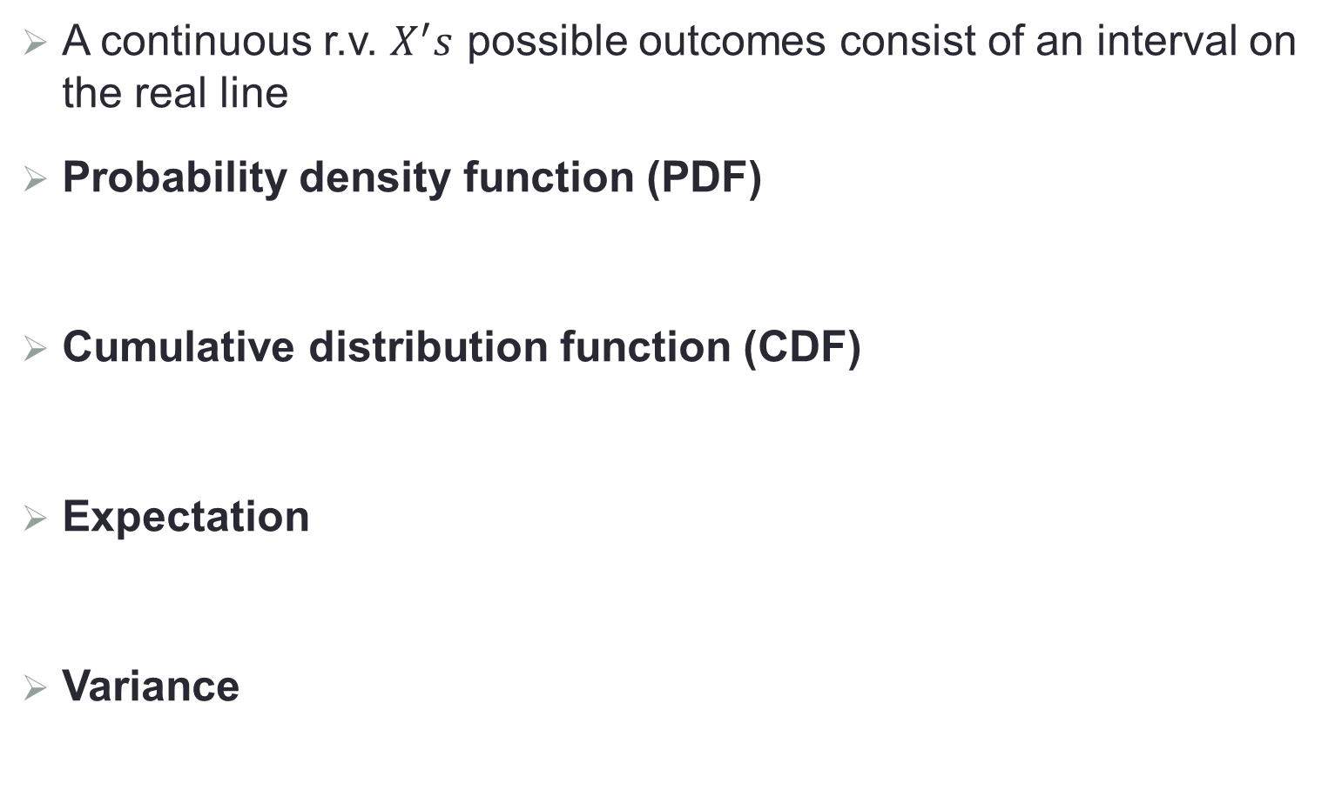
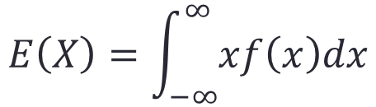
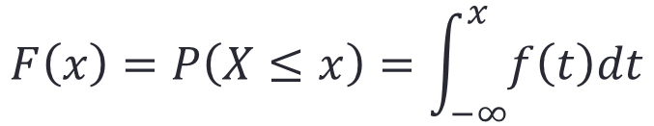
Continuous Random Variable
A continuous r.v. $X^{′}s$ possible outcomes consist of an interval on the real line
Probability density function (PDF)
Cumulative distribution function (CDF)
Expectation
Variance
$$f\left(x\right)=\lim_{h→0}{P(x≤X≤x+h)}$$
$$F\left(x\right)=P\left(X≤x\right)=\int_{−∞}^{x}{f\left(t\right)dt}$$
$$E\left(X\right)=\int_{−∞}^{∞}{xf\left(x\right)dx}$$
$$Var\left(X\right)=E{\left[X−E(X)\right]}^{2}=E\left(X^{2}\right)−{\left[E(X)\right]}^{2}$$

Slide 21
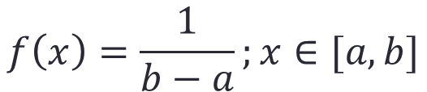
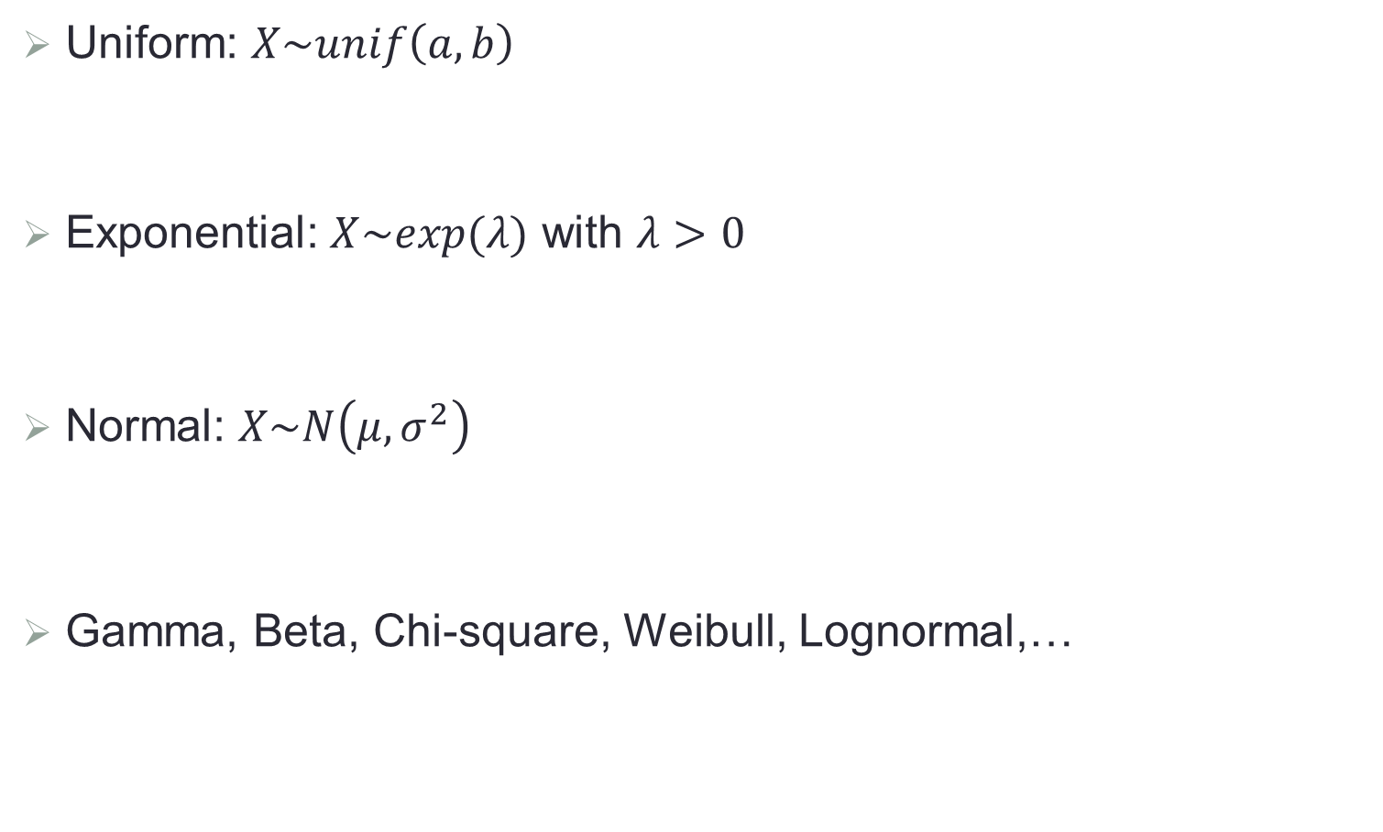
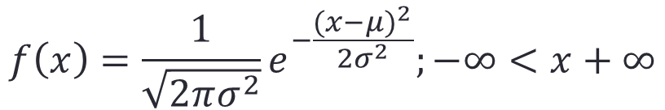

Popular Continuous Random Variables
Uniform: $X\sim unif\left(a,b\right)$
Exponential: $X\sim exp(λ)$ with $λ>0$
Normal: $X\sim N\left(μ,σ^{2}\right)$
Gamma, Beta, Chi-square, Weibull, Lognormal,…
$$f\left(x\right)=\frac{1}{b−a};x∈[a,b]$$
$$f\left(x\right)=λe^{−λx};x>0$$
$$f\left(x\right)=\frac{1}{\sqrt{2πσ^{2}}}e^{−\frac{{(x−μ)}^{2}}{2σ^{2}}};−∞<x+∞$$

Slide 22
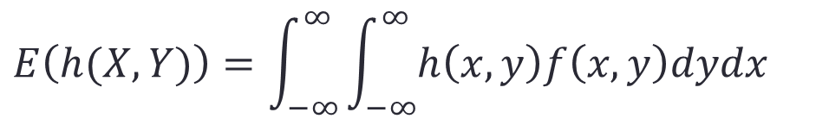
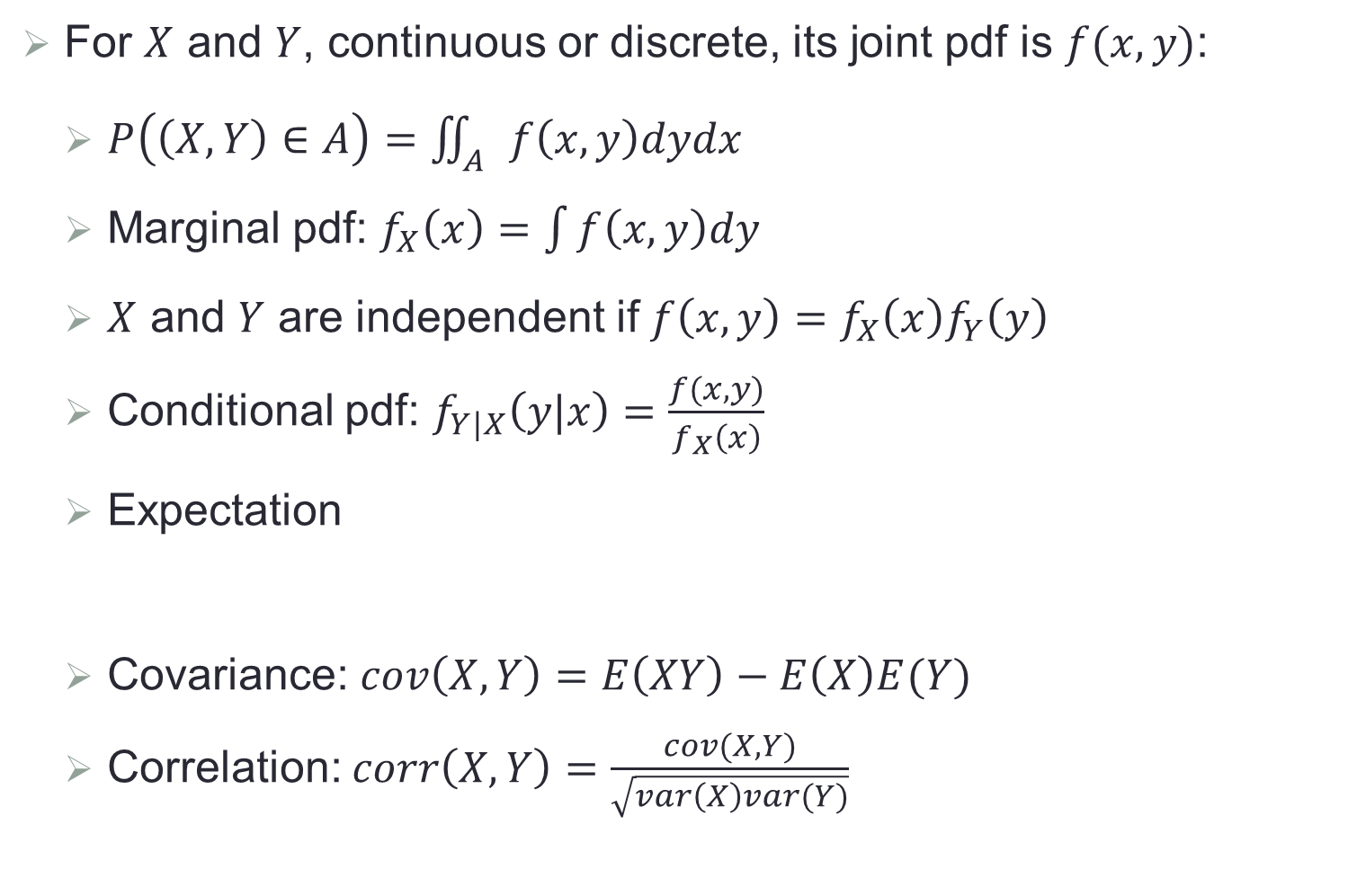
Joint Distribution
For $X$ and $Y$, continuous or discrete, its joint pdf is $f(x,y)$:
$P\left(\left(X,Y\right)∈A\right)=\iint_{A}{f\left(x,y\right)dydx}$
Marginal pdf: $f_{X}\left(x\right)=\int{f\left(x,y\right)dy}$
$X$ and $Y$ are independent if $f\left(x,y\right)=f_{X}\left(x\right)f_{Y}\left(y\right)$
Conditional pdf: $f_{Y|X}\left(y|x\right)=\frac{f(x,y)}{f_{X}\left(x\right)}$
Expectation
Covariance: $cov\left(X,Y\right)=E\left(XY\right)−E\left(X\right)E(Y)$
Correlation: $corr\left(X,Y\right)=\frac{cov(X,Y)}{\sqrt{var\left(X\right)var(Y)}}$
$$E\left(h(X,Y)\right)=\int_{−∞}^{∞}{\int_{−∞}^{∞}{h\left(x,y\right)f\left(x,y\right)dydx}}$$

Slide 23
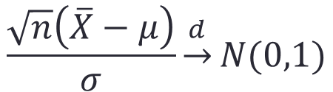
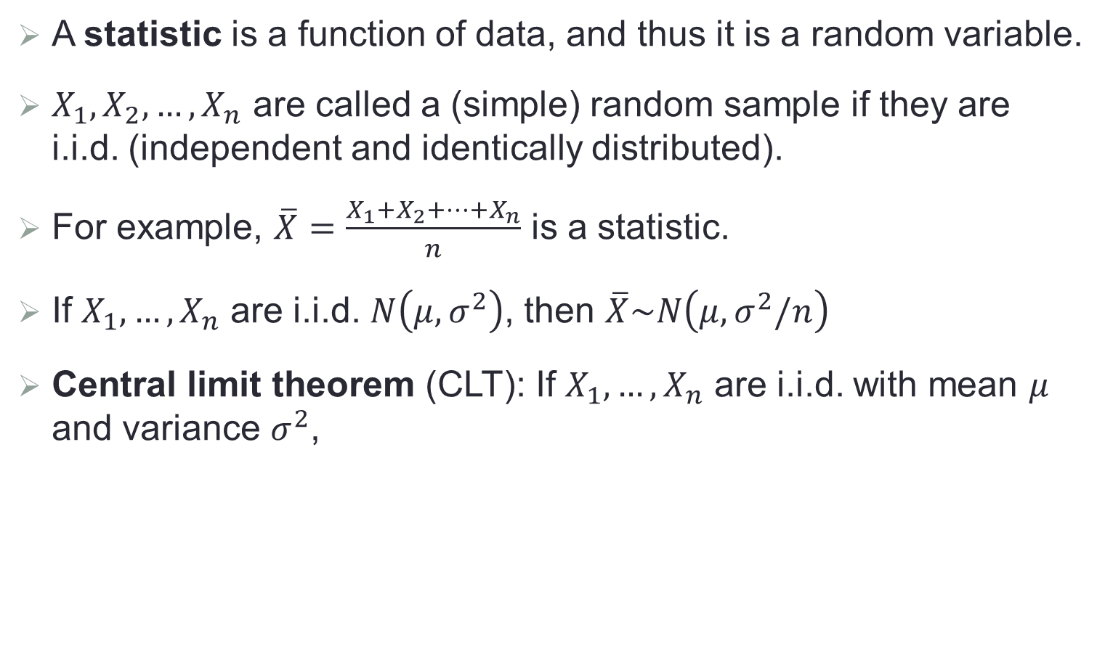
Statistics and Their Distribution
A statistic is a function of data, and thus it is a random variable.
$X_{1},X_{2},…,X_{n}$ are called a (simple) random sample if they are i.i.d. (independent and identically distributed).
For example, $\overline{X}=\frac{X_{1}+X_{2}+…+X_{n}}{n}$ is a statistic.
If $X_{1},…,X_{n}$ are i.i.d. $N\left(μ,σ^{2}\right)$, then $\overline{X}\sim N\left(μ,σ^{2}/n\right)$
Central limit theorem (CLT): If $X_{1},…,X_{n}$ are i.i.d. with mean $μ$ and variance $σ^{2}$,
$$\frac{\sqrt{n}\left(\overline{X}−μ\right)}{σ}\underset{→}{d}N(0,1)$$

Slide 24
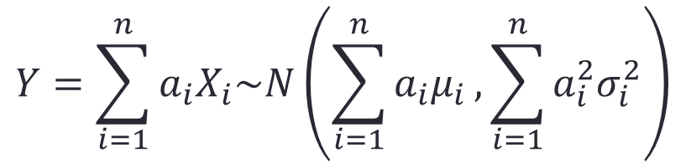
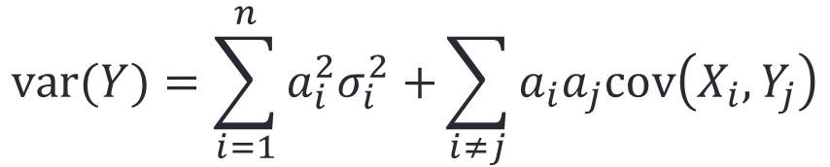
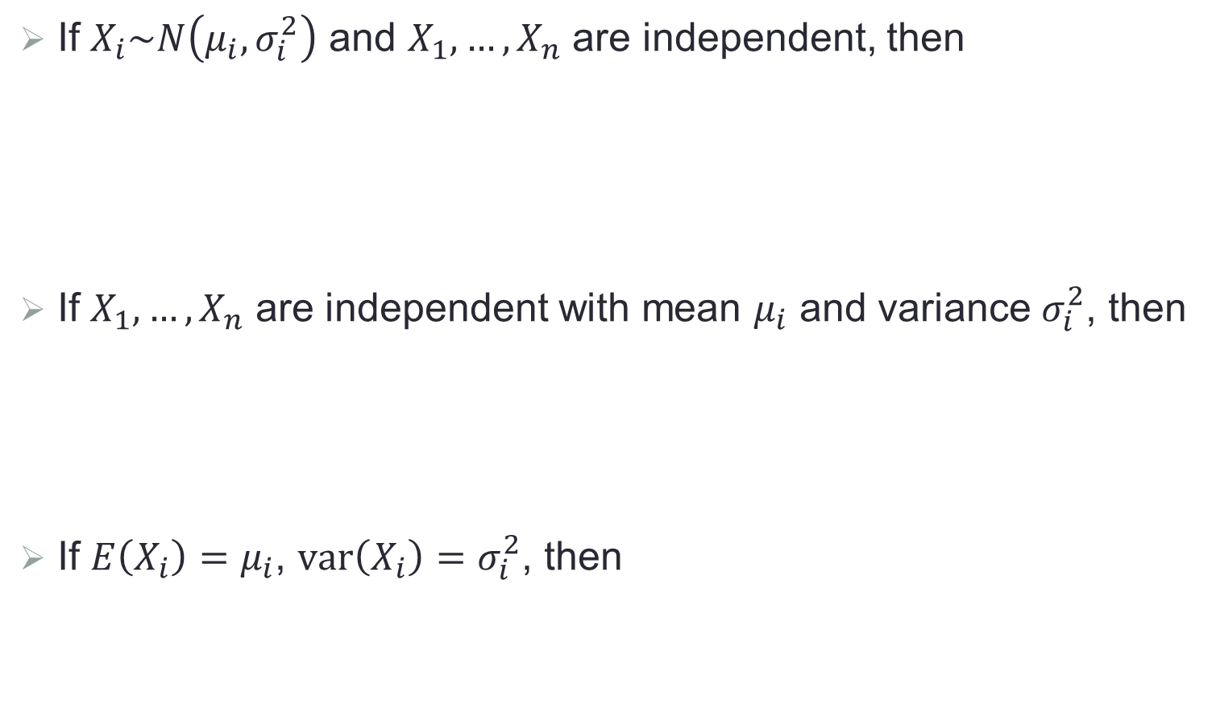
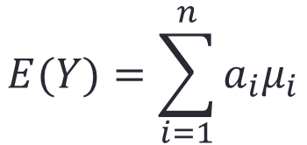
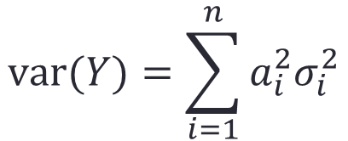
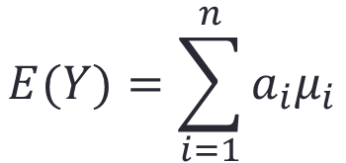
Some General Results
If $X_{i}\sim N\left(μ_{i},σ_{i}^{2}\right)$ and $X_{1},…,X_{n}$ are independent, then
If $X_{1},…,X_{n}$ are independent with mean $μ_{i}$ and variance $σ_{i}^{2}$, then
If $E\left(X_{i}\right)=μ_{i}$, $var\left(X_{i}\right)=σ_{i}^{2}$, then
$$Y=\sum_{i=1}^{n}{a_{i}X_{i}\sim N\left(\sum_{i=1}^{n}{a_{i}μ_{i}},\sum_{i=1}^{n}{a_{i}^{2}σ_{i}^{2}}\right)}$$
$$E(Y)=\sum_{i=1}^{n}{a_{i}μ_{i}}$$
$$var(Y)=\sum_{i=1}^{n}{a_{i}^{2}σ_{i}^{2}}$$
$$E(Y)=\sum_{i=1}^{n}{a_{i}μ_{i}}$$
$$var(Y)=\sum_{i=1}^{n}{a_{i}^{2}σ_{i}^{2}+}\sum_{i≠j}{a_{i}a_{j}cov\left(X_{i},Y_{j}\right)}$$

Slide 25
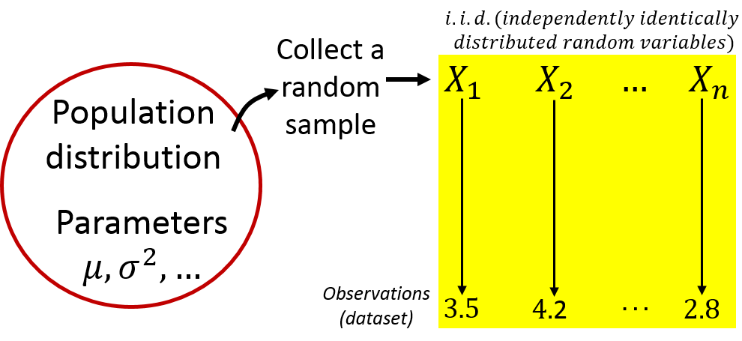
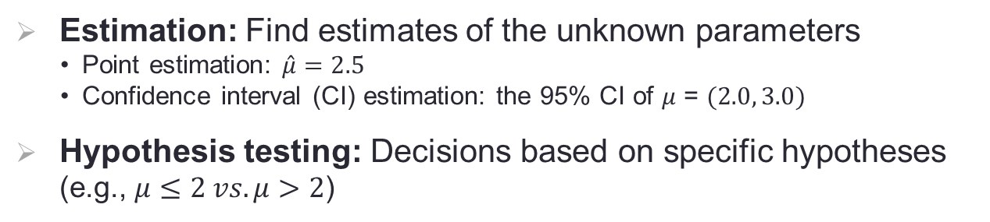
Statistical Inference
Find truth on the population based on the data obtained from a sample of the population
Estimation: Find estimates of the unknown parameters
  Point estimation: $\hat{μ}=2.5$
  Confidence interval (CI) estimation: the 95% CI of $μ$ = $(2.0, 3.0)$
Hypothesis testing: Decisions based on specific hypotheses (e.g., $μ≤2 vs. μ>2$)

Slide 26
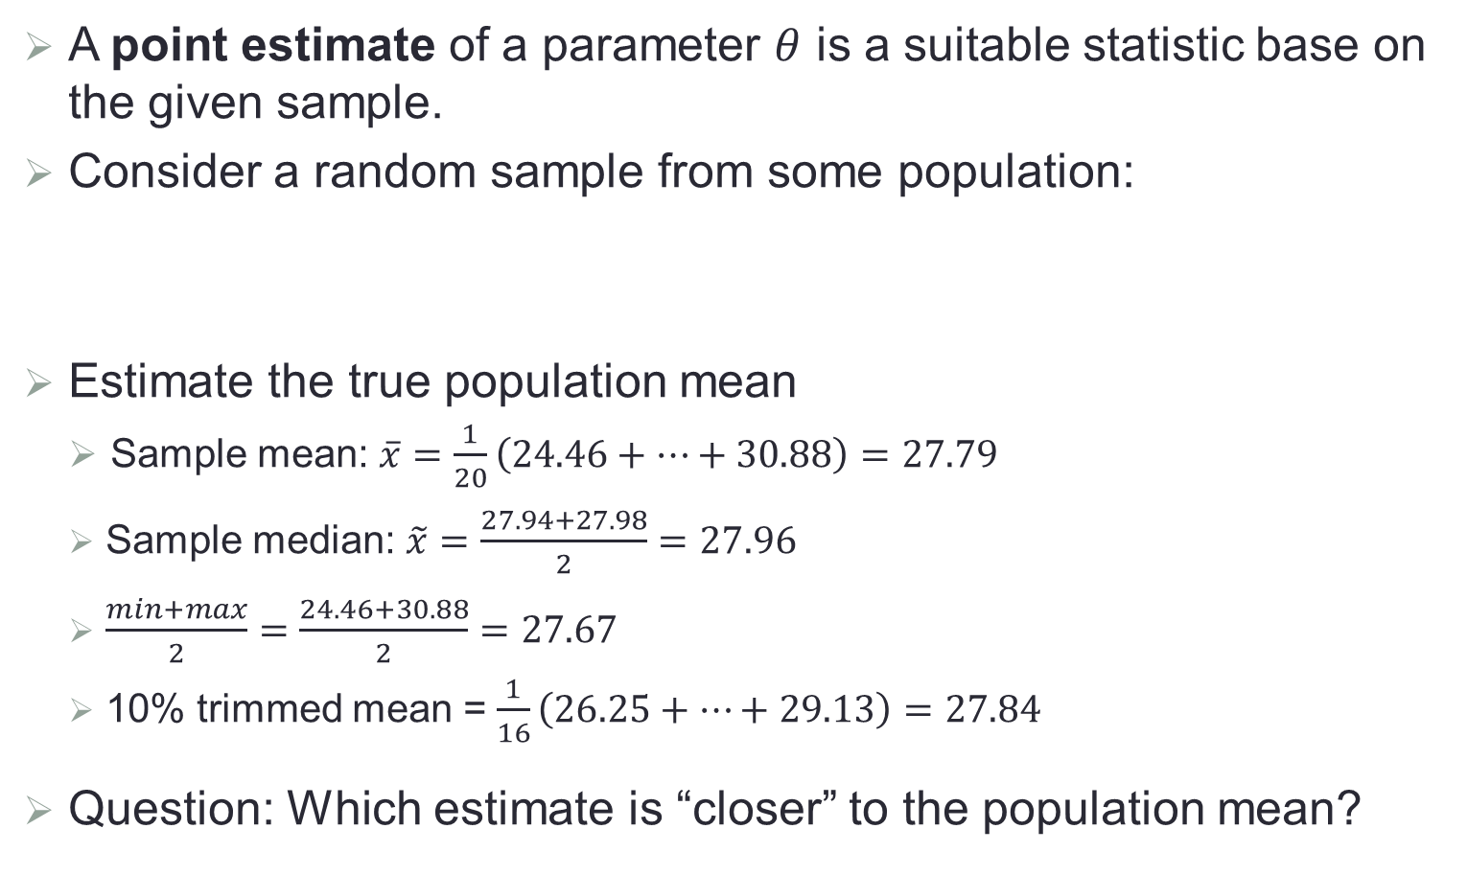
Point Estimation
A point estimate of a parameter $θ$ is a suitable statistic base on the given sample.
Consider a random sample from some population:
Estimate the true population mean
Sample mean: $\overline{x}=\frac{1}{20}\left(24.46+…+30.88\right)=27.79$
Sample median: $\tilde{x}=\frac{27.94+27.98}{2}=27.96$
$\frac{min+max}{2}=\frac{24.46+30.88}{2}=27.67$
10% trimmed mean = $\frac{1}{16}\left(26.25+…+29.13\right)=27.84$
Question: Which estimate is “closer” to the population mean?

Slide 27
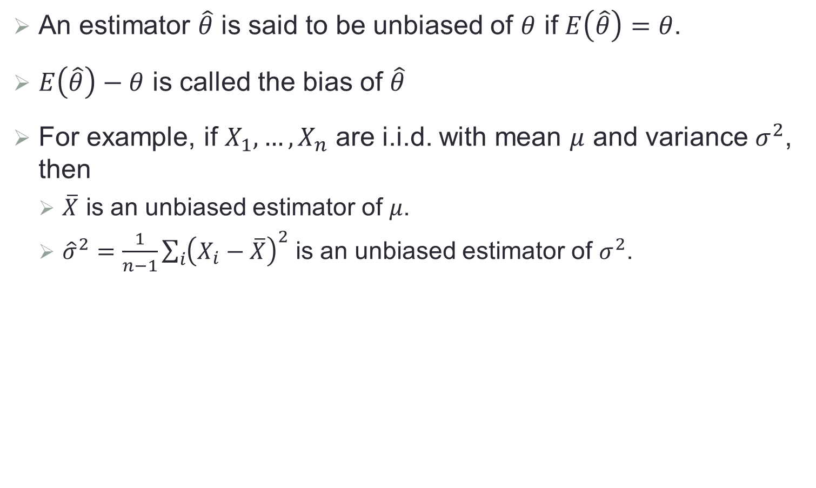
Unbiased Estimator
An estimator $\hat{θ}$ is said to be unbiased of $θ$ if $E\left(\hat{θ}\right)=θ$.
$E\left(\hat{θ}\right)−θ$ is called the bias of $\hat{θ}$
For example, if $X_{1},…,X_{n}$ are i.i.d. with mean $μ$ and variance $σ^{2}$, then
$\overline{X}$ is an unbiased estimator of $μ$.
${\hat{σ}}^{2}=\frac{1}{n−1}\sum_{i}{{\left(X_{i}−\overline{X}\right)}^{2}}$ is an unbiased estimator of $σ^{2}$.

Slide 28
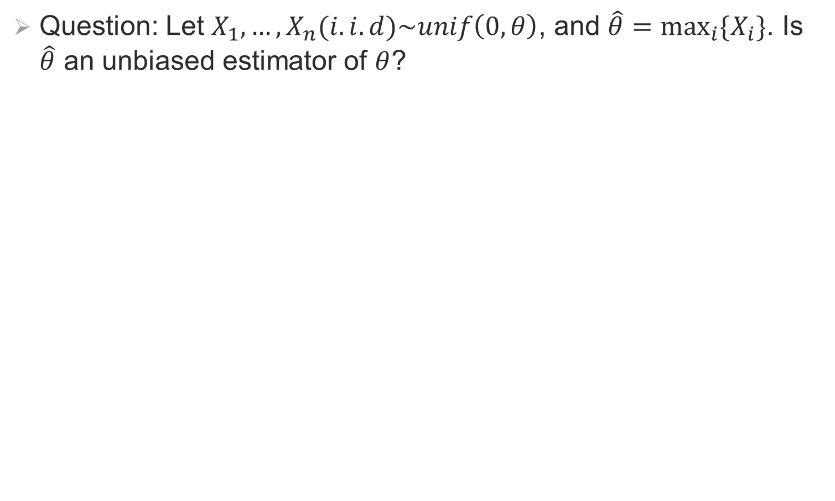
Another Example
Question: Let $X_{1},…,X_{n}(i.i.d)\sim unif\left(0,θ\right)$, and $\hat{θ}=\max_{i}{\{X_{i}\}}$. Is $\hat{θ}$ an unbiased estimator of $θ$?

Slide 29


MVUE
Among all unbiased estimators, choose the one that has minimum variance.
The resulting $\hat{θ}$ is called the minimum variance unbiased estimator (MVUE) of $θ$.
In the previous example, let ${\hat{θ}}_{1}=\frac{n+1}{n}\max_{i}{\{X_{i}\}}$ and ${\hat{θ}}_{2}=2\overline{X}$. Both are unbiased, but
If $X_{1},…,X_{n}(i.i.d)\sim N\left(μ,σ^{2}\right)$, then $\hat{μ}=\overline{X}$ is the MVUE of $μ$.
Difficult to find MVUE in general
$var\left({\hat{θ}}_{1}\right)=\frac{θ^{2}}{n(n+1)}≤var\left({\hat{θ}}_{2}\right)=\frac{θ^{2}}{3n}$ when $n≥1$

Slide 30

Method of Moments (MM)
The $kth$ population moment is $E(X^{k})$, and the $kth$ sample moment is $\frac{1}{n}\sum_{i=1}^{n}{X_{i}^{k}}$.
Let $X_{1},…,X_{n}$ be i.i.d. from $f(x;θ)$, then the MM estimator is obtained by equating population moments to the corresponding sample moments and solving for $θ$.
For example, if $X_{1},…,X_{n}(i.i.d)\sim N\left(μ,σ^{2}\right)$, then

Slide 31

Maximum Likelihood Estimator (MLE)
Let $X_{1},…,X_{n}$ have joint pdf $f(x_{1},…,x_{n};θ)$, which can also be regarded as a function of $θ$, called the likelihood function.
The MLE estimator $\hat{θ}$ is the value of $θ$ that maximizes the likelihood function, so that
$f(x_{1},…,x_{n};θ)≤f(x_{1},…,x_{n};\hat{θ})$; for any $θ$
For example, if $X_{1},…,X_{n}(i.i.d)\sim N\left(μ,σ^{2}\right)$, then

Slide 32

Another Example
Question: Let $X_{1},…,X_{n}(i.i.d)\sim unif\left(0,θ\right)$, find the MM and MLE estimators of $θ$?

Slide 33



Confidence Interval
A confidence interval (CI) is an interval estimate, computed based on certain statistics, that may contain the unknown population parameter with pre-specified probability.
For example, if $X_{1},…,X_{n}$ is a random sample from $N(μ,σ_{0}^{2})$ with known $σ_{0}^{2}$, the $100\left(1−α\right)\%$ CI for $μ$ is
For another example, the $100\left(1−α\right)\%$ CI for $μ$ of a normal distribution with unknown $σ$ is
$$\left(\overline{X}−z_{\frac{α}{2}}\frac{σ_{0}}{\sqrt{n}},\overline{X}+z_{\frac{α}{2}}\frac{σ_{0}}{\sqrt{n}}\right)$$
$$\left(\overline{X}−t_{\frac{α}{2},n−1}\frac{s}{\sqrt{n}},\overline{X}+t_{\frac{α}{2},n−1}\frac{s}{\sqrt{n}}\right)$$

Slide 34


Interpretation of CI
CI is a random interval whose endpoints are random.
More specifically, get 100 random samples independently from the population, and construct CI for each sample.
Out of the 100 CIs, about $100\left(1−α\right)$ of them will cover $μ$.

Slide 35


A General Procedure for CI
In general, let $X_{1},…,X_{n}$ be a random sample on which $\hat{θ}$is constructed to estimate a parameter $θ$, satisfying
approximately normal
unbiased (at least approximately)
$var\left(\hat{θ}\right)=σ_{\hat{θ}}^{2}$ is available
Then $P\left(−z_{α/2}≤\frac{\hat{θ}−θ}{σ_{\hat{θ}}}≤z_{α/2}\right)≈1−α$, and thus an approximate $100\left(1−α\right)\%$ CI for $θ$ is
$$\left(\hat{θ}−z_{\frac{α}{2}}σ_{\hat{θ}}, \hat{θ}+z_{\frac{α}{2}}σ_{\hat{θ}}\right)$$

Slide 36

Hypothesis Test
A hypothesis is a claim about certain characteristics of a probability distribution.
A hypothesis test is a method for using data to decide between two competing claims about a population characteristic.
The null hypothesis, denoted by $H_{0}$, is the claim that is initially assumed to be true.
The alternative hypothesis, denoted by $H_{a}$, is the competing claim that is contradictory to $H_{0}$.

Slide 37

Testing Procedure
Usually, for $H_{0}: θ=θ_{0}$, three possible alternatives:
$H_{a}: θ>θ_{0}$
$H_{a}: θ<θ_{0}$
$H_{a}: θ≠θ_{0}$
A test procedure is a rule based on sample data, for deciding whether to reject $H_{0}$
A test statistic: a function of the sample data on which the decision is to be based
Rejection region: the set of all values of the test statistic for which $H_{0}$ will be rejected.

Slide 38


Error Types
The probability of Type I error is also known as the significance level, usually denoted by $α$.
The probability of Type II error is denoted by $β$, and $1−β$ is known as the power.
Typically, increasing the significance level $α$ results in a smaller value of $β$ for any parameter value consistent with $H_{a}$.
Construct a test procedure to minimize $β$, provided that its significance level is controlled by a pre-specified $α$.

Slide 39

P-value
The p-value is the smallest level of significance at which $H_{0}$ will be rejected when the test is used on a given dataset.
If p-value < $α$, then reject $H_{0}$; otherwise, fail to reject $H_{0}$.
The p-value is the probability, calculated assuming that $H_{0}$ is true, of obtaining a value of the test statistic at least as contradictory to $H_{0}$ as the value calculated from the available sample data.
Usually, $α$ is set as 0.05, but use it with caution!

